Slide 1

Autumn 2 | RE
Enquiry: Why does Christmas matter to Christians? | Christianity: Incarnation/God
 | What will I learn? Christians believe that Jesus is God and that he was born as a baby in Bethlehem. The Bible points out that his birth showed he was extraordinary and that he came to bring good news All Christians celebrate Jesus’ birth How Christians around the world celebrate the birth of Jesus | What words will I use? advent gospel nativity tradition incarnation symbolise Big Frieze

Slide 2
Autumn 2 | RE
Enquiry: Why does Christmas matter to Christians? | Christianity: Incarnation/God
 | What will I learn? Christians believe that Jesus is God and that he was born as a baby in Bethlehem. The Bible points out that his birth showed he was extraordinary and that he came to bring good news All Christians celebrate Jesus’ birth How Christians around the world celebrate the birth of Jesus | What words will I use? advent gospel nativity tradition incarnation symbolise Big Frieze

Slide 3
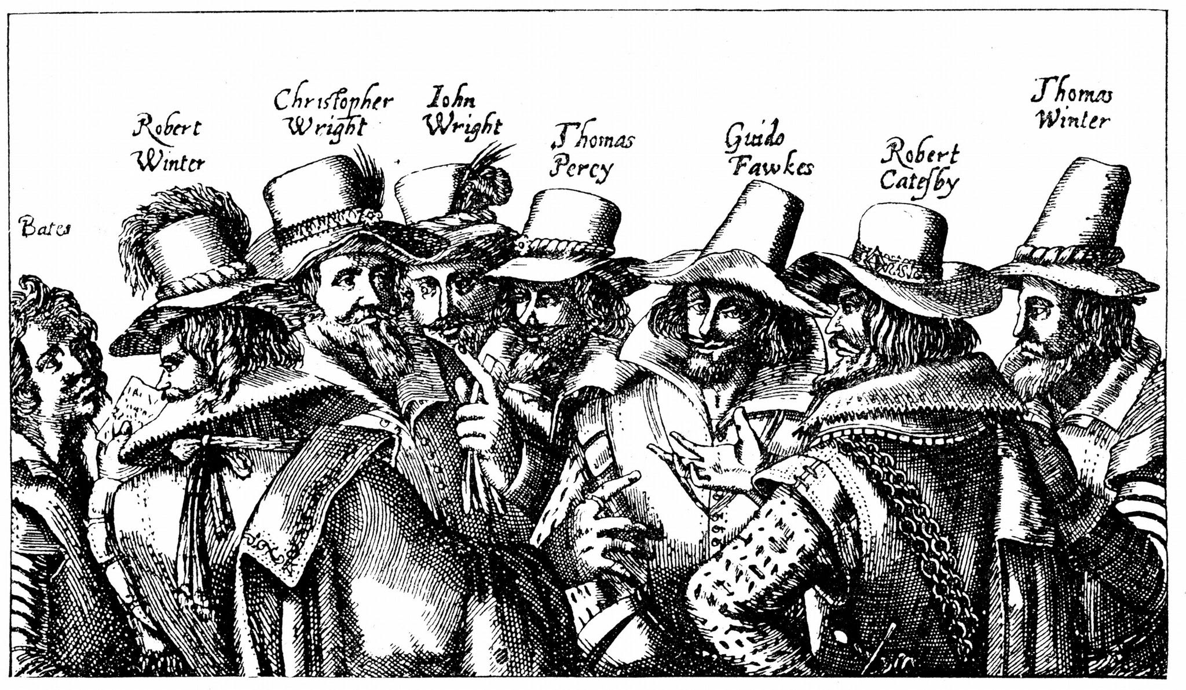
Autumn 2 | History
Enquiry: Why did the Gunpowder Plot happen? | Remember, Remember!
 | What will I learn? the significance of Guy Fawkes. the original cause of the carnival and the impact that this has had on the town. why the Gunpowder Plot happened who Henry VIII was and why he chose to separate from the Catholic Church | What words will I use? gunpowder plot Carnival Reformation Tudor Catholic Church of England

Slide 4
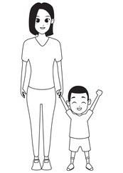
Autumn 2 | Science
Enquiry: What is an animal? | Animals including humans
 | What will I learn? animals, including humans, have offspring which grow into adults. the young of some animals don’t look like their parents the basic needs of animals, including humans, for survival are: water, food, air, and shelter. to grow into healthy adults, animals, including humans, need exercise, the right amounts of different types of food and good hygiene. | What words will I use? offspring reproduction growth adult toddler old person survival hygiene food types

Slide 5
Autumn 2 | Science
Enquiry: What is an animal? | Animals including humans
 | What will I learn? animals, including humans, have offspring which grow into adults. the young of some animals don’t look like their parents the basic needs of animals, including humans, for survival are: water, food, air, and shelter. to grow into healthy adults, animals, including humans, need exercise, the right amounts of different types of food and good hygiene. | What words will I use? offspring reproduction growth adult toddler old person survival hygiene food types

Slide 6

Autumn 2 | Music
Enquiry: What is pitch? | Tuned Percussion - Musical Me
 | What will I learn? To understand and practise reading different symbols to show pitch. To sing and draw pitch patterns To read and understand the notation for the song ‘Once a Man Fell in a Well.’ To use a tuned percussion instrument to play a song To complete the notation for a short song using a three line stave | What words will I use? pitch notation tuned percussion stave

Slide 7

Autumn 2 | Computing
Enquiry: How can we capture and edit photographs? | Digital photography
 | What will I learn? To use a digital device to take a photograph. To make choices when taking a photograph. To describe what makes a good photograph. To describe how photographs can be improved. To use tools to change an image. To recognise that photos can be changed. | What words will I use? capture portrait landscape format composed photographer composing light focus artificial autofocus

Slide 8

Autumn 2 | PSHE
Enquiry: How does our character shape our world? | Celebrate
 | What will I learn? How we all have different character strengths and these are something to celebrate. Discussing how character strengths can be genetic and through experiences. About love and kindness as a character strength. About bravery and honesty as a character strength. Exploring and learning as a character strength. Teamwork and behaviour as a character strength. Love of life and our world as a character strength. | What words will I use? unique special strength spotting neuroplasticity grow

Slide 9
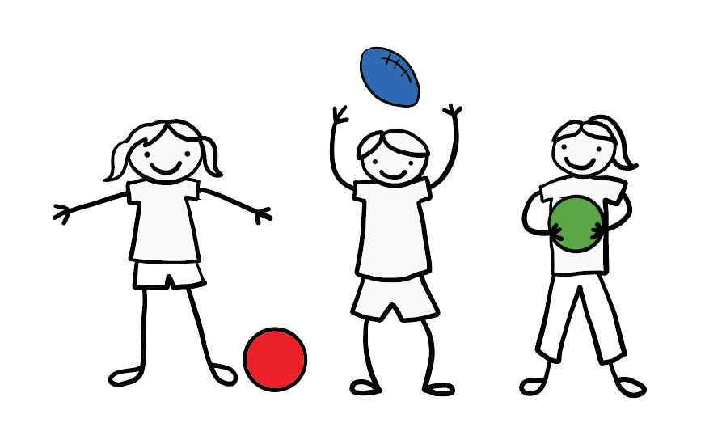
Autumn 2 | PE
Enquiry: How can we develop our fundamental ball skills? | Ball Skills
 | What will I learn? To roll a ball to hit a target. To develop stopping a rolling ball. Develop a dribbling ball with your feet. To develop kicking a ball. To develop throwing and catching. To develop dribbling a ball with your hands. | What words will I use? throwing catching rolling target dribbling

