Slide 1

Spring 1 | RE
Enquiry: Who made the world? | Christianity: Creation
 | What will I learn? The story of creation How the story of creation fits into the ‘big story’ of the Bible To use Art to represent the story of creation To think about gratitude for the world To show gratitude in different ways | What words will I use? Creation God Adam and Eve Bible Gratitude

Slide 2
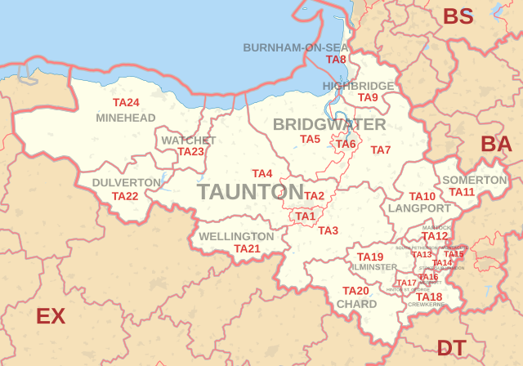
Spring 1 | Geography
Enquiry: Why is Bridgwater special and who wants to live here? | Bridgwater is Special!
 | What will I learn? How to collect data about a town What is an aerial view and how to use them The difference between physical and human features The significance of features of Bridgwater How to design our own town map | What words will I use? Data Aerial view Physical feature Human feature Map Key

Slide 3

Spring 1 | Science
Enquiry: How can different materials be used for a specific purpose | Materials
 | What will I learn? Naming materials The properties of materials Uses of materials How materials can change shape Investigation skills | What words will I use? Wood Metal Plastic Glass Brick Rock Paper Cardboard Material Squash Bend Twist Stretch Waterproof

Slide 4

Spring 1 | Music
Enquiry: How can I use my voice to perform a composition | Singing: Theme ‘On this island’
 | What will I learn? To learn to sign a British folk song To practise and perform a song relating to the countryside. To practise and perform a song relating to the city. To create symbols to represent sounds. To develop and perform a musical composition. | What words will I use? Sing Folk song Perform Pitch Lyrics Collaborate Communicate Composition Dynamics Notation

Slide 5

Spring 1 | Computing
Enquiry: What can pictograms be used for? How can we create one? | Data and Information - Pictograms
 | What will I learn? How we can count and compare objects using tally charts. That objects can be represented as pictures. How to create a pictogram. What is an attribute? How to select objects by attribute and make comparisons. That people can be described by attributes and use this to compare. How to create a ‘block diagram’. Share their data and and discuss findings as well as discussing when it is ok to share their data. | What words will I use? tally chart organise more than less than pictogram attribute computer program

Slide 6

Spring 1 | PSHE
Enquiry: How does our character shape our world? | Celebrate
 | What will I learn? How we all have different character strengths and these are something to celebrate. Discussing how character strengths can be genetic and through experiences. About love and kindness as a character strength. About bravery and honesty as a character strength. Exploring and learning as a character strength. Teamwork and behaviour as a character strength. Love of life and our world as a character strength. | What words will I use? unique special strength spotting neuroplasticity grow

Slide 7

Spring 1 | PE
Enquiry: How can use our body and movements to tell a story and perform | Dance
 | What will I learn? To remember, repeat and link actions to tell a story of a dance. How dynamics can be used to show an idea. To remember, repeat and copy actions using facial expressions to show different characters. To explore pathways and levels. To create and perform unison, mirroring with a partner. To remember and repeat action and dance as a group. | What words will I use? Unison Mirroring Levels Pathways Actions Dynamics Patterns

