Slide 1

Parents & Friends Association
Chair’s Report 2023-24

Slide 2
Our successes
Successful events supported by staff and parents, loved by children – Carols by Candlelight, Disco, Summer Fair
Introduction of online ticketing
Establishment and growth of Easyfundraising
New initiatives – Fund-raisin, disco tuck shop, business match giving, World Book Day book sale, Easter competition
Reaching our target to purchase the Reading Lodge
Great support from PFA link staff member (Mrs Hall!) and school SLT
Small committee – big impact on our children

Slide 3
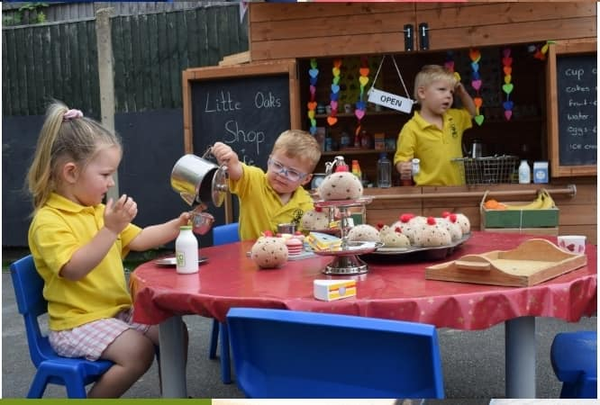
Our challenges and opportunities
Low involvement from parent body makes events very challenging
Small committee means high workload / pressure at times for some
Impact on school ‘business’ of staff being involved in events
Cost of living crisis impacting on many families
Local businesses have ‘raffle fatigue’ and less likely to donate

Slide 4

Our challenges and opportunities
Expand committee / volunteers to have better representation from other year groups
Utilise online fundraising opportunities more
Explore new and different fundraising that requires less volunteers and time
Systems, materials, experience now exist which will reduce some time
Identify a new project and consider bids / grants

Slide 5


