Slide 1
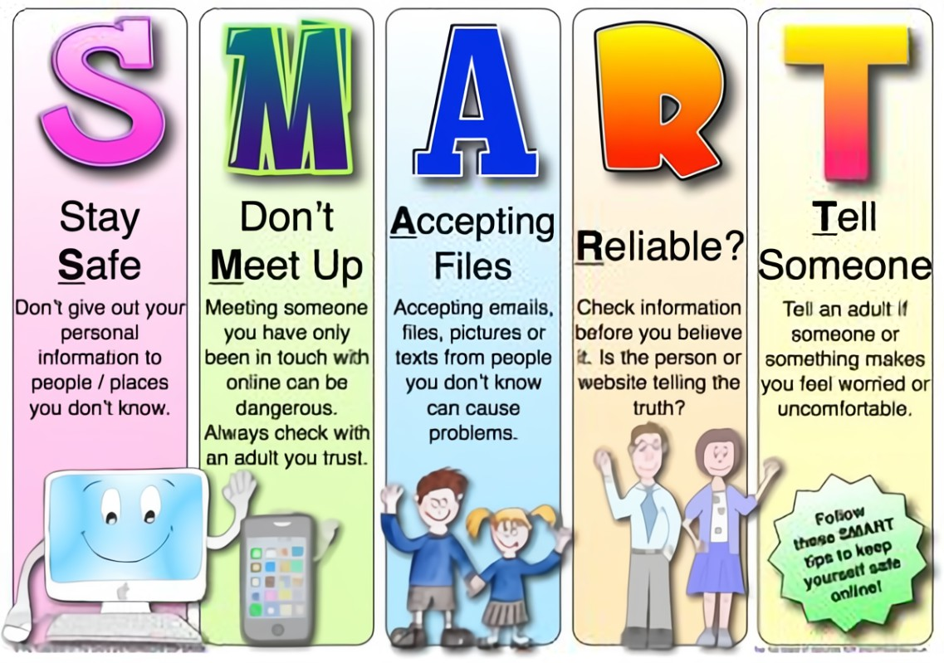
Useful information for Parents and Schools:
Cyber protect Resources:
National Online Safety: https://nationalonlinesafety.com
Think you know: www.thinkuknow.co.uk
Internet Matters: https://www.internetmatters.org/
Common Sense Media: https://www.commonsensemedia.org/
Special Educational Needs Children:
Star TOOLKIT - Looking at online safety with young people with SEND – New resource from Childnet - UK Safer Internet Centre
ONLINE ABUSE OF CHILDREN WITH SEND - Children with SEND | TALK Checklist by Internet Watch Foundation (iwf.org.uk)
Supporting children and young people with SEND - https://www.internetmatters.org/inclusive-digital-safety/advice-for-parents-and-carers/supporting-children-with-send/

Slide 2

Newsletter February 2023
Online Apps and Gaming
Gaming
ROBLOX provides design elements to help budding game creators make and contribute games and activities. Most are free to play once you register and download an installer, and there are plenty to check out.
Users can also chat with and friend each other, join groups, and post on message boards. The games can be inconsistent novice developers make them, so quality can vary and younger kids may find some a bit scary.
Safety features allow parents to limit some of kids' chat and other features by changing their account settings.
https://www.internetmatters.org/parental-controls/gaming-consoles/roblox-parental-controls/
Roblox contains what is known as micro-transaction; when gamers can buy extra, small sized content for the game to enhance or customise their experience. These can be weapons for fighting games, clothes or ‘skins’ in order to look like your favourite characters from other games or franchises.
Older teens (aged between 13-18) are hacking accounts that have previously made purchases for such content and are locking the user out, asking for money or just stealing items (in game) that are rare and worth a lot of money. Extortion, bullying and theft have been found to occur on this game and we have seen items worth £1000s to the online community which make it attractive to criminals and pose risk to your child.
There is no official age that kids can play Roblox, but Common Sense Media rates the platform safe for users 13+ "based on continuing challenges with problematic content.
Players can use the communication features of Roblox to talk to one other while they are playing. This means that there is a risk of cyberbullying or unwanted contact.
Links are being shared in the chat rooms which are very appealing and when opened may transfer the kids to webchat rooms like Omegle.

Slide 3

Gaming
Crime, violence, sex, drugs, and alcohol = not for kids.
“In this open-world action game, players assume the role of three criminals whose storylines intersect within the fictional city of Los Santos. Players can switch between each character to follow his storyline, completing missions that often include criminal activities (e.g., stealing cars, executing heists, assassinating targets).
The game includes depictions of sexual material/activity: implied fellatio and masturbation; various sex acts that the player’s character procures from a prostitute -while no nudity is depicted in these sequences, different sexual moaning sounds can be heard.”
18+
Downloadable content (DLC) surrounding drugs and heists etc. has become available. It is extra content that is based on drug running, drug empire building and gang wars surrounding territorial control. Players are encouraged to take out competitors drug labs and resources to then collect these materials for yourself to build (and create/make) your own drug business etc.
This is encouraging young people to learn about the ins and outs of the drug trade (based in America), albeit fabricated and exaggerated but encouraging non-the-less.
Children in Year 3 and 4 are playing this game.
One of the most popular games for Primary Aged Children!

Slide 4

Gaming
Each server on Discord has both text and voice channels.
Discord is the easiest way to talk over voice, video, and text. Talk, chat, hang out, and stay close with your friends and communities. With the right privacy settings and monitoring, it's easy to use Discord safely. However, there's always a risk when it comes to sites and apps with open chat. The safest way to use Discord is to only accept friend requests and participate in private servers with people you already know.
https://www.commonsensemedia.org/articles/parents-ultimate-guide-to-discord
Discord requires that users be at least 13 years old, although they do not verify users' age upon signup. Common Sense Media also recommends that Discord users be at least 13 due to its open chat.
Discord is the chatting platform where gamers generally find like-minded people to share their game or chat with.
After the pandemic, it became a hotspot for non-gamers due to its fun and exciting features.
Online predators have been known to use this chat facility to groom young people.
Discord is very popular in primary and secondary school students!!.
Cases in our force area of children being groomed online on Discord; sending inappropriate photographs of themselves or being sent inappropriate content to watch.

Slide 5

Report Remove - Childline
How does Report Remove work?
Young people aged 13+ are first directed to Yoti to verify their age using ID (our legal remit means we can only remove images of children.) Children aged under 13 do not need to prove their age.
Once children have proved they are younger than 18, they are prompted to create a Childline account, which allows them to be safeguarded and supported throughout the process.
Young people are then taken to a dedicated IWF portal where they can securely upload images, videos or URLs (website addresses).
IWF analysts assess the reported content and take action if it meets the threshold of illegality*. The content is given a unique digital fingerprint (a hash) which is then shared with internet companies to help prevent the imagery from being uploaded or redistributed online.
The outcome will be conveyed to Childline who will then contact the young person via their Childline account to keep them updated and offer further support.
https://www.childline.org.uk/info-advice/bullying-abuse-safety/online-mobile-safety/remove-nude-image-shared-online/

