Slide 1

Parents & Friends Association
Chair’s Report 2024-25

Slide 2
Our successes
Successful fundraising throughout the year, including many ‘ongoing’ initiatives such as Easyfundraising, The School Lottery, clothes bank, Tesco token fundraiser etc.
Fundraising meant the PFA bank account was able to recover from low levels following the large expenditure of the Reading Lodge
Events which created lovely memories for our children such as the Christmas Movie Night (new this year), Wonder Bar sales, World Book Day stall and Colour Run
A small growth in PFA Helpers, with wonderful support from those who gave some time to help
Continued business match giving, with thanks to our Treasurer Sarah Ballantine for organising
Great continued support from PFA link staff member (Mrs Hall!)
Small committee – big impact on our children

Slide 3
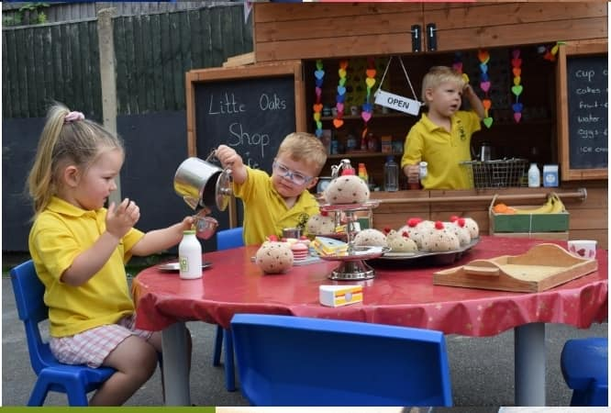
Our challenges and opportunities
Low involvement from parent body makes events very challenging
Small committee means high workload / pressure when working towards an event
Cost of living crisis impacting on many families
Local businesses have ‘raffle fatigue’ and less likely to donate
Negative feedback from the school community very demoralising

Slide 4

Our challenges and opportunities
Expand committee / volunteers to have better representation from other year groups
Utilise online fundraising opportunities more
Explore new and different fundraising that requires less volunteers and time
Systems, materials, experience now exist which will reduce some time
Identify a new project and consider bids / grants

Slide 5


